Slide 1



REPUBLIC OF CAMEROON Peace-Work-Fatherland
REPUBLIC DU CAMEROUN Paix-Travail-Patrie
COMPUTERISED PLATFORM FOR THE DAILY COLLECTION IN A MICROFINANCE
Written by:
WIRBA JORDAN WIRBA
Level III Software engineering Student

Slide 2

INTRODUCTION
CONTEXT AND PROBLEMATICS
METHODOLOGY
DEMOSTRATION
CONCLUSION
1
2
3
4
5

Slide 3


2
CONTEXT & PROBLEMATICS
COMPUTERISED PLATFORM FOR THE DAILY COLLECTION IN A MICROFINANCE

Slide 4


Slide 5



Slide 6


Slide 7


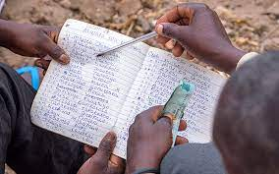
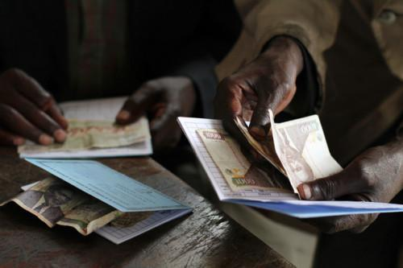

2
CONTEXT & PROBLEMATICS
PROBLEMATICS
HOW TO FACILITATE THE TRANSACTION PROCESS BETWEEN CONTRIBUTORS AND COLLECTORS IN A SECURED AND EFFICIENT WAY.

Slide 8




2
CONTEXT & PROBLEMATICS
SOLUTION

Slide 9

3
Functional branch
Technical branch
METHODOLOGY
Capture functional needs
Capture technical needs
Analysis
Generic design
Prototype
Preliminary design
Detailed design
Coding and test
Recipe
Realization branch

Slide 10
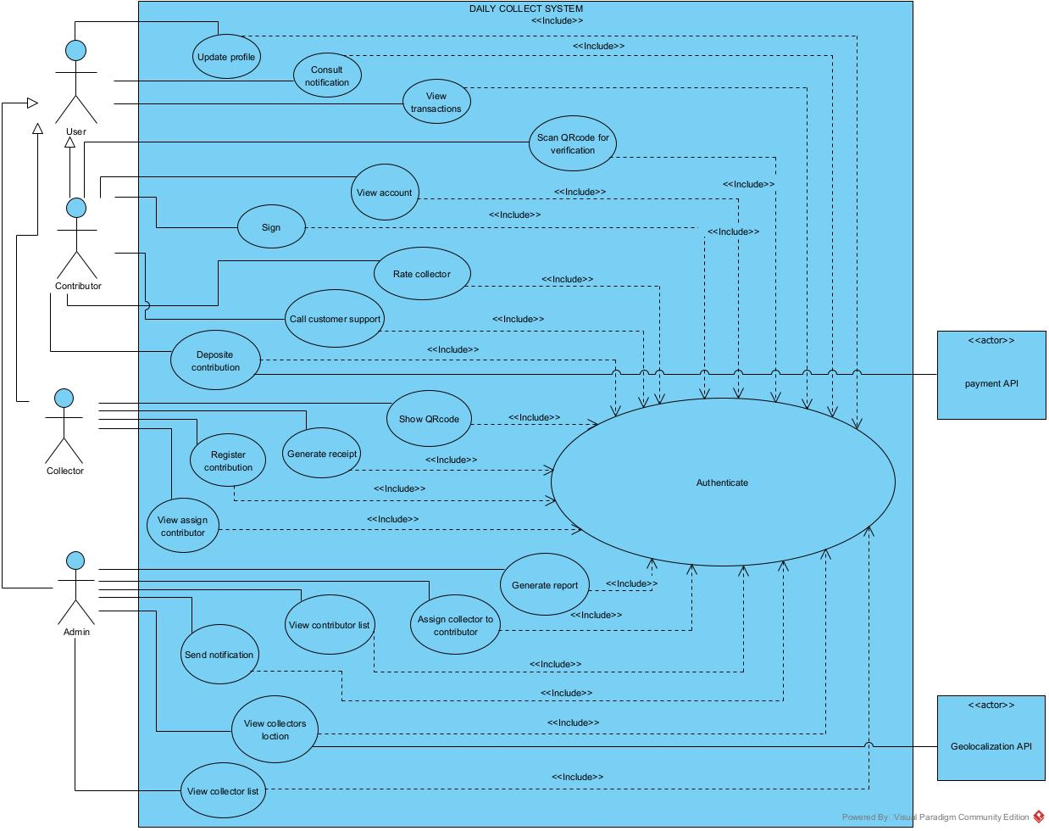
3
METHODOLOGY
GENERAL USE CASE DIAGRAM

Slide 11
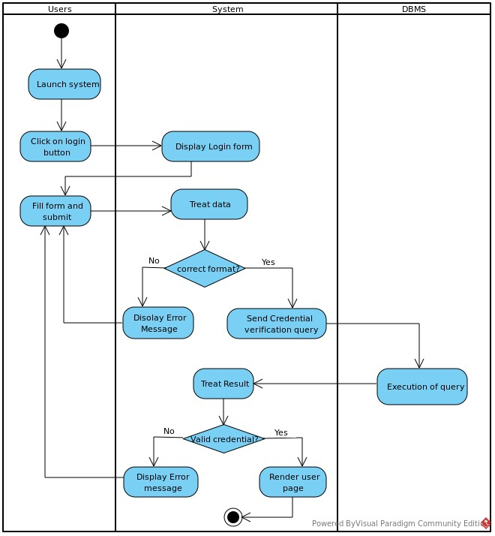
3
METHODOLOGY
AUTHENTICATION ACTIVITY DIAGRAM

Slide 12
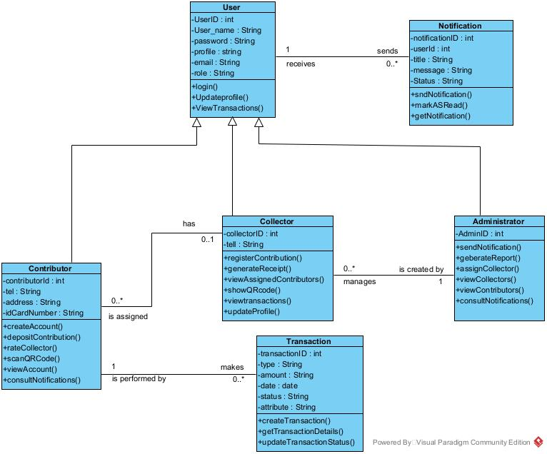
3
METHODOLOGY
SYSTEM CLASS DIAGRAM

Slide 13
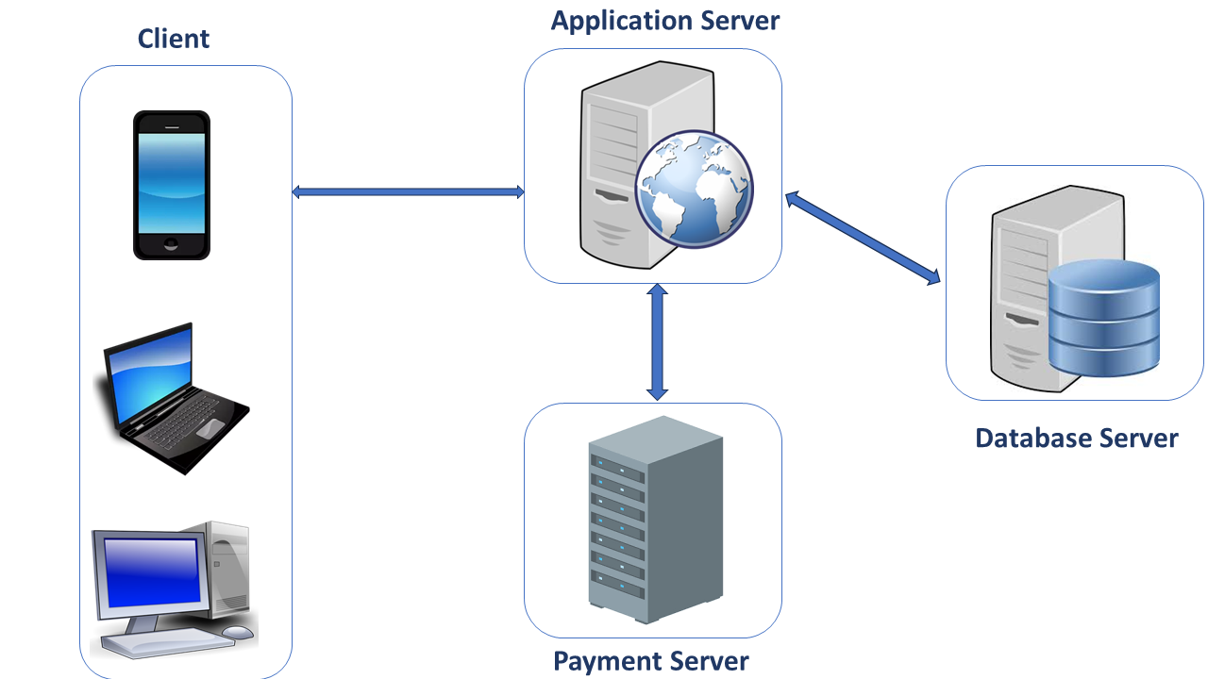
3
METHODOLOGY
PHYSICAL ARCHITECTURE

Slide 14
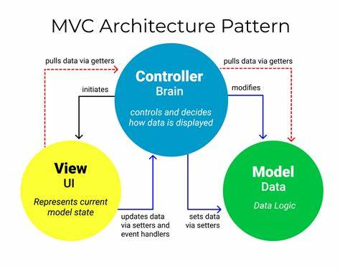
3
METHODOLOGY
LOGICAL ARCHITECTURE

Slide 15








3
METHODOLOGY
TOOLS USED
FRONT-END
BACKED-END
OTHERS TOOLS

Slide 16


4
DEMONSTRATION

Slide 17
5
CONCLUSION
PERSPECTIVES
As perspective we we will implement:
A payment API to facilitate the transactions
A geolocalisation API for tracking the location of collectors when they in service.
Developing a mobile application

Slide 18

5
CONCLUSION

